Slide 1
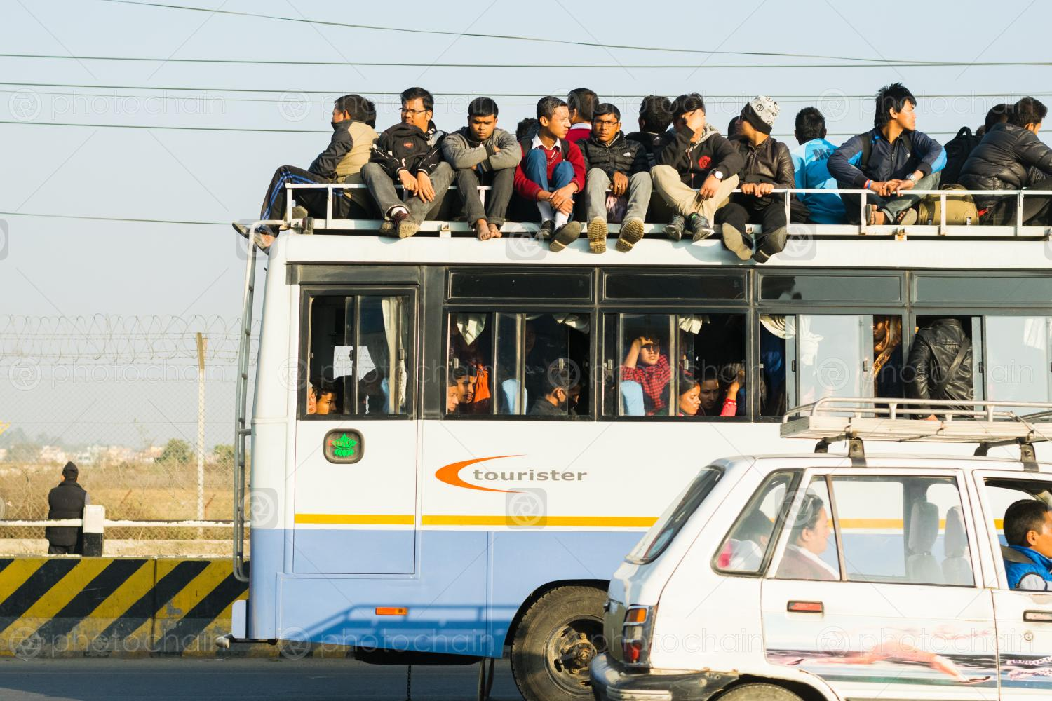
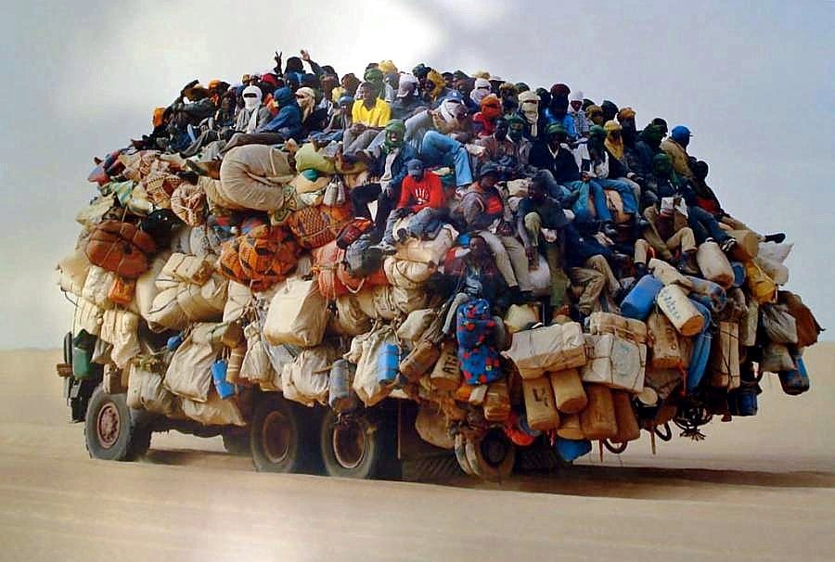
Method Overloading & Overriding in Java
By :
Malisetty Prasanth
Batch – (JR-3)
CAPG2021B1LS0446
Date: 17-04-2021

Slide 2

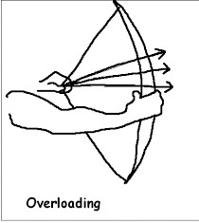
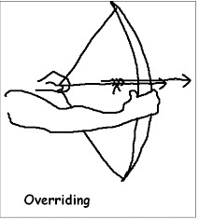
Pictorial Representation of Overloading & Overriding

Slide 3
Polymorphism Types :
Polymorphism
Static Polymorphism
Dynamic Polymorphism
Method Overloading
Method Overriding

Slide 4
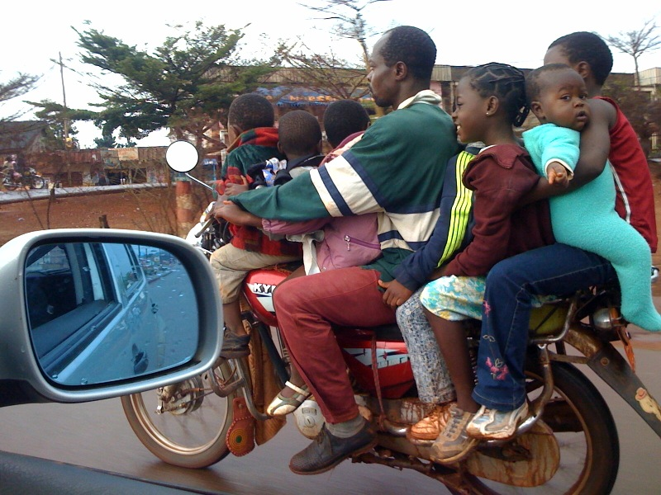
Method Overloading :
Overloading occurs when two or more methods in one class have the same method name but different parameters.

Slide 5
Why is this called static polymorphism?
Well that’s because which overloaded methods is to be invoked or not, is decided at compile time, based on the actual number of arguments and the compile-time types of the arguments.

Slide 6
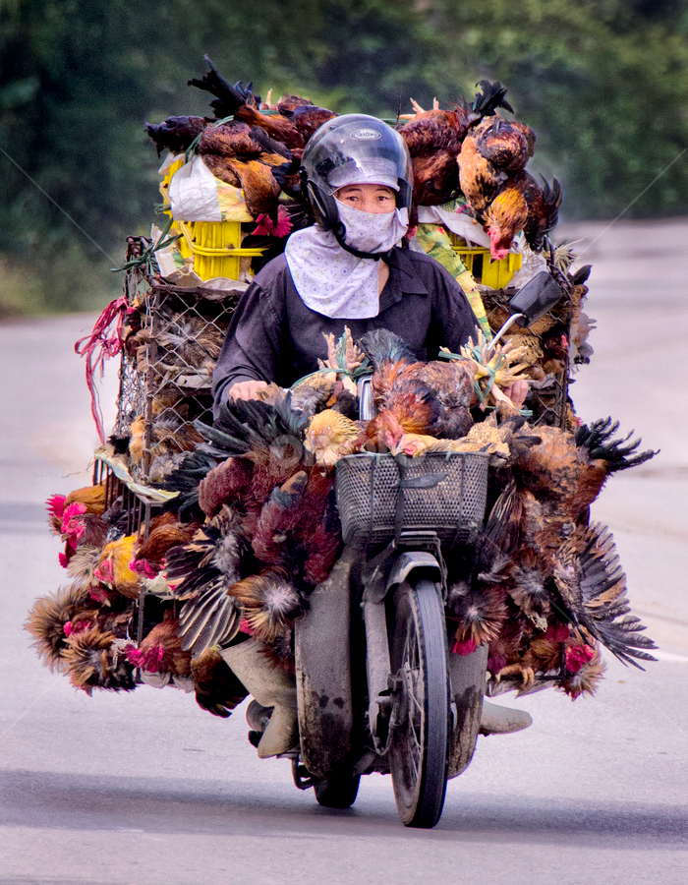
Method Overriding :
Overriding occurs when two methods have the same method name and parameters. One of the methods is in the parent class, and the other is in the child class.

Slide 7
Why is this called dynamic polymorphism?
Runtime polymorphism or Dynamic Method Dispatch is a process in which a call to an overridden method is resolved at runtime rather than compile-time.

Slide 8


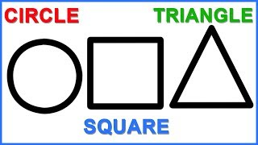
Case Study :

Slide 9

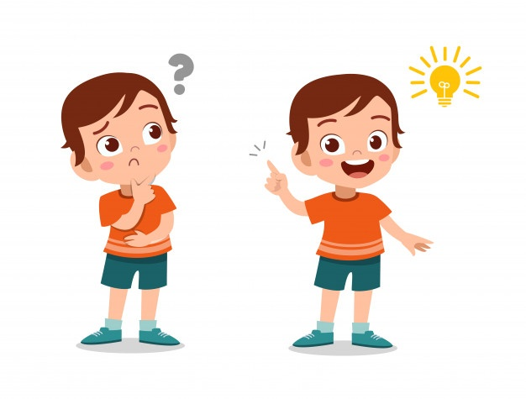

Method Overloading :
public class Shape{
//It could be a circle or rectangle or square
private String type;
//To calculate area of rectangle
public Double area(Long length, Long breadth){
return (Double) length * breadth;
}
//To calculate area of a circle
public Double area(Long radius){
return (Double) 3.14 * r * r;
}
}

Slide 10
Method Overriding :
public abstract class Shape{
public abstract Double area();
}
public class Circle extends Shape {
private Double radius = 5.0;
// See this annotation @Override, it is telling that this method is from parent
// class Shape and is overridden here
@Override
public Double area(){
return 3.14 * radius * radius;
}
}

Slide 11

Most good programmers do programming not because they expect to get paid, but because it is fun to program.
------Linus Torvalds

